Slide 1
Leximetric analysis of drug laws and evaluation of outcomes: cross-country analyses approach
Wednesday, 23 October
Carla Rossi, Centro Studi Statistici e Sociali, prof.carla.rossi@gmail.com
Francesca de Marinis, magistrate
Simone Borra, University of Rome ‘Tor Vergata’
Italy

Slide 2
Topics covered
Leximetric approach chosen for the prior evaluation of the drug laws (and policies) producing input- driven indices (Francesca De Marinis);
Countries chosen as examples of drug laws and policies in 31 years (1991-2021): Italy as a base, having been studied in detail before, Netherlands, France and Portugal;
Leximetric evaluation and comparison of leximetric scores;
Some key social indicators for posterior evaluation of the consequences of drug laws as output-driven indices;
Comparative study of some indicator values.

Slide 3
Leximetric scores for Italy: input-driven indicators
In the laws more or less harsh consequences for the users and suppliers are provided and therefore a score can be assigned proportional to the expected level of repression:
Administrative penalty: score from 0-5 depending on the degree of strength.
Criminal sanction: score from 5-10, depending on the level of maximum penalty established for the crime.
In Italy, as an example of drug law:
  art. 75 (and 75 bis) related to consumers (administrative penalty);
  and art. 73 related to drug sellers (criminal sanction).

Slide 4
Administrative penalties and Criminal sanctions in Italy (1990-2021) Variables | D.P.R. n. 309/90 (1990 -2006) | Law n. 49/2006 (2006 - 2014) | Law n. 79/2014 (2014 - 2021)
How is the sale of ‘hard drugs’ punished? | 10 | 10 | 10
How is the sale of ‘soft drugs’ punished? | 8 | 10 | 8
How is the cultivation of ‘hard drugs’ punished? | 10 | 10 | 10
How is the cultivation of ‘hard drugs’ for personal use punished? | 10 | 10 | 10
How is the cultivation of ‘soft drugs’ punished? | 8 | 10 | 8
How is the cultivation of ‘soft drugs’ for personal use punished? | 8 | 10 | 8
How is the consumption (i.e. detention for personal use) of ‘hard drugs’ punished? | 2 | 5 | 5
How is the consumption (i.e. detention for personal use) of ‘soft drugs’ punished? | 2 | 5 | 5
Who, after being caught detaining drugs for personal use, can voluntarily start a therapeutic treatment, avoiding any administrative sanction? | 0 | 1 | 1
If someone with a drug addiction has committed a crime can they benefit from a suspension of the sentence if they start a therapeutic programme? | 0 | 1 | 1
If someone with a drug addiction has committed a crime, during or before the execution of the sentence, can they access a therapeutic programme outside of jail? | 0 | 0 | 0
Total, degree of severity of the law | 58 | 72 | 66

Slide 5
Level of repression – Italy (1990 – 2021)

Slide 6
Italy: some output-driven indices and leximetric scores
corresponding to art. 73 of the 3 laws

Slide 7
General leximetric scores
For Italy, there are only administrative consequences for consumers and only criminal consequences for drug dealers.
This makes it easy to define a leximetric scale distinguishing between consumers and drug dealers.
In the general case, one must extend the definition by setting leximetric scores as values of the type ‘xy.z’ between 0 and less than 6 for administrative consequences and between 6 and less than 11 for criminal consequences.
It is not possible to reserve scores for consumers and dealers respectively.

Slide 8
Leximetric scores for pushers related to the law in action in the countries

Slide 9
Cost associated with the legal repression of illicit drug supply: focus on detention
Output-driven indices
Cost related to detention, 2010.
Cost related to detention, 2018.
Country | Total estimated cost for the detention of all drug offenders, 2010 (in €) | Annual prison expenditure (in €) | Population as of 1st January 2010* | Expenditure for drug offenders as a percentage of the total prison population expenditure | Per capita expenditure for drug related detention (€)
Italy (Law n. 49/2006) | 633,201,357 | 1,602,252,910 | 59,433,744 | 39.51 | 10.65
Portugal | 40,678,520 | 195,629,780 | 10,572,721 | 20.79 | 3.84
Country | Total estimated cost for the detention of all drug offenders, 2018 (in €) | Annual prison expenditure (in €) | Population as of 1st January 2018* | Expenditure for drug offenders as a percentage of the total prison population expenditure | Per capita expenditure for drug related detention (€)
Italy (Law n. 79/2014) | 615,708,280 | 1,934,559,276 | 60,484,000 | 31.82 | 10.18
Portugal | 27,450,738 | 174,881,684 | 10,291,000 | 15.69 | 2.67
- In Portugal, the law and policy on illegal drugs is more health-oriented than repressive
compared to the law and policy in Italy.
- In Italy, the law on illegal drugs was somewhat lightened from repression in 2014 by the
Constitutional Court.
- The ratio of the cost of living in Italy compared to Portugal is 1.5.
- The ratio of the per capita expenditure for drug detention was 2.78 in 2010 and 3.81 in 2018.

Slide 10
Leximetric scores for consumers related to the law in action in the countries
Consumers (hard drugs)

Slide 11
Output-driven indices (critical aspects)
Monitoring methodologies are different in different countries.
Some differences depend directly on the type of law.
Others, involving estimates of prevalences and incidences of different populations of users, depend greatly on both the type of data being used and the methodologies.
In order to compare data from national reports, delivered under Reitox to past EMCDDA (presently EUDA), are considered.
In particular the Treatment demand data set, related to 2020, is considered to provide some examples.
Data collected under ESPAD international is also considered.
Just on ESPAD data, related to 2011, new indices, that quantitatively measure poly-drug use, are shown.

Slide 12
Age at first use
Data from EUDA's statistical bulletin on subjects placed in treatment in different years were considered.
Several characteristics of these subjects were studied, such as age at first substance use.
The graphs represent the percentage distributions by age of first use with respect to cannabis and cocaine powder in subjects entering treatment in 2020.
Netherlands could not be included because the data is missing for 2020. The last data reported is for 2015.

Slide 13
Age at first treatment
Similar trends are found in age at first treatment.
From the cumulative distributions we geometrically derive the medians resulting in the next class for Portugal with respect to Italy and France for cannabis as for cocaine together with Italy.

Slide 14
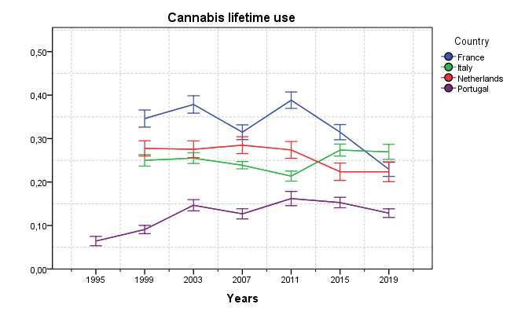
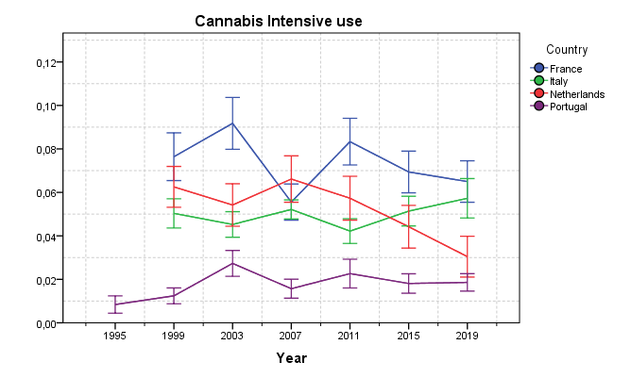
ESPAD (cannabis use)
We consider the lifetime and frequent use reported by 16-year-olds attending high school in the 4 countries considered.
As can be seen, countries with more repressive laws observe greater and even more intensive use of cannabis. Repression is apparently not working.
Special attention will be paid in the ongoing work to the Netherlands since their comprehensive cannabis law is disharmonious, not repressive for consumers but repressive for producers and sellers, this leads to criminal organizations growth.

Slide 15
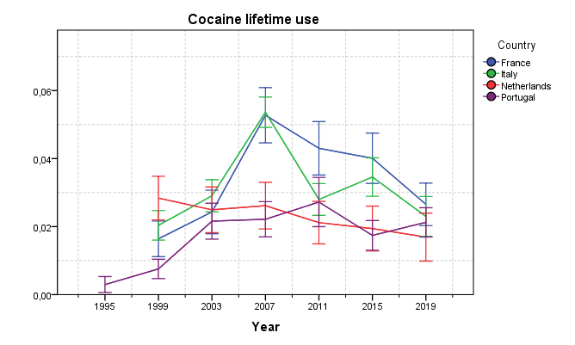
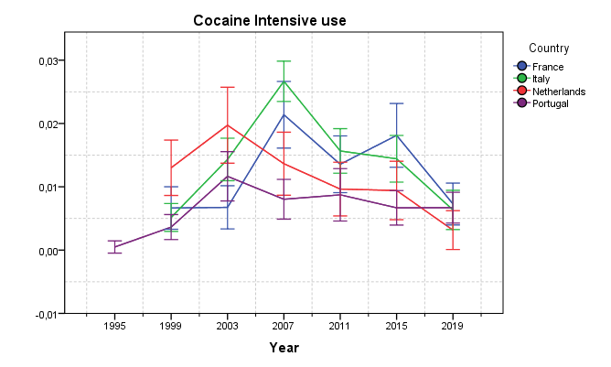
ESPAD (cocaine powder use)
Quite similar situation is observed for cocaine powder. In Italy and in France higher percentages of lifetime and heavy-use users are found.
A positive effect of the 2000 law is observed for Portugal as, after an initial uptick in cannabis and cocaine powder use immediately after the new law, in subsequent years all trends in the use of both are stable or decreasing, specifically for intensive users.
Similar trends are also found for crack cocaine and heroin.
These trends will be considered in ongoing work.
It is important to consider poly-use as an end point.

Slide 16
Poly-drug use (ESPAD 2011)
PDS (poly-drug use indicator)
The 2011 ESPAD survey is the largest and most comprehensive of the project's surveys because it allowed the use of the new indices, introduced in an EU project, that assess health harms for substance users by taking into account both the type of substance and frequency of use and also poly-use.
We here report only the values of the means and medians of poly-drug use indicator and poly-drug use frequency for the different countries considered.
Portugal has globally the lowest indicators for poly-drug use.
References provide information on documents reporting the basis of the shown results.
An extensive comparison of drug laws and corresponding policies between Italy and Portugal before 2013 is reported in Ventura and Rossi (2013) as the laws in further countries.
Country | Mean | Median
Italy | 0.44 | 0.27
France | 0.24 | 0.08
Netherlands | 0.23 | 0.08
Portugal | 0.18 | 0.05
FUS (poly-drug use frequency indicator)
Country | Mean | Median
Italy | 21.89 | 7
France | 19.94 | 7.5
Netherlands | 19.55 | 7.5
Portugal | 20.74 | 4

Slide 17
More information and the basis for ongoing work in the references
In the references are reported:
The basis for leximetric analysis and the application on the various laws in force in Italy, over the past 30 years;
Information on costs of supply repression according to the law in action;
Information on poly-drug use; new indicators and applications on adolescent populations;
Important information on the impact of changes in law or policy on cannabis use (ESPAD data set) in the work by Elisa Benedetti et al. (2021), where the abstract concludes:
’Some forms of restrictive intervention reduce the general prevalence of use and more liberal reforms seem linked to an increase in the share of students initiating use of cannabis. We find no evidence of an effect of policy changes on the share of frequent users, which are presumably those more likely to develop use-related health consequences.’
Further analysis is planned, as part of an inter-university project, on additional data and countries.

Slide 18
References
Elena Ventura and Carla Rossi editors. Drug laws in Europe: main features and comparisons, UniversItalia di Onorati s.r.l., Roma, ISBN 978-88-6507-401-5, 2013.
Alessia Mammone, Francesco Fabi, Emanuela Colasante, Valeria Siciliano, Sabrina Molinaro, Ludwig Kraus, Carla Rossi, New indicators to evaluate and to compare harmful drug use among adolescents in 38 European countries, NORDIC STUDIES ON ALCOHOL AND DRUGS VOL 31, 2014, 243-258.
Ventura E., Wagner H., Rossi C., (2015). New indicators of health among adolescent drug users and evaluation of drug policies comparing countries, Epidemiology, Biostatistics and Public Health, vol. 12-1, suppl.1.
Elisa Benedetti, Giuliano Resce, Paolo Brunori, Sabrina Molinaro , Cannabis Policy Changes and Adolescent Cannabis Use: Evidence from Europe, Int. J. Environ. Res. Public Health 2021,18, 5174. https://doi.org/10.3390/ijerph18105174
Francesca De Marinis and Carla Rossi (2022). Leximetric analysis of drug laws and evaluation of policy effectiveness. 11 e-IJLSR (2022), 2, 452-474.
https://drive.google.com/file/d/1dXxfXzKHqm9DyU_8ZldIaXPglMIWUmlK/view
Francesco Fabi, Emanuela Colasante, Sabrina Molinaro, Gianpaolo Scalia Tomba and Carla Rossi, Quantitative assessment of high school students’ poly-drug use: related social aspects, and school dropout, Current Drug Research Reviews, 2023, Vol.15, No. 2, 177-187.
Luca Di Censi and Francesco Fabi, Estimating the costs of the criminal justice system, in Carla Rossi and Susanna Conti editors. Evaluating the Impact of Laws Regulating Illicit Drugs on Health and Society. Bentham Books, Sharjah, U.A.E, 2023.
Carla Rossi and Susanna Conti editors. Evaluating the Impact of Laws Regulating Illicit Drugs on Health and Society. Bentham Books, Sharjah, U.A.E, 2023.

Slide 19
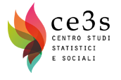
Thank you very much
for your attention

